Slide 1
Identity, Entitlement and Access Management
Syed Aquib
Security Fundamentals For Cloud

Slide 2
CC ZG504, Cloud Security Foundations Lecture No.3

Slide 3
Agenda
Part 1: Introduction to IAM (30 minutes)
Introduction to Identity, Entitlement, and Access Management
The Challenges of IAM in the Cloud
IAM Best Practices
Part 2: Authentication Techniques (45 minutes)
Authentication: Proving You Are Who You Say You Are
Multi-Factor Authentication (MFA)
Passwordless Authentication
Access Control Methods
Practical Threat Modeling Techniques
Part 3: Advanced IAM Concepts (30 minutes)
Identity Federation
Privileged Access Management (PAM)
IAM Trends and Future Directions
Q&A and Group Activity (30 minutes)

Slide 4
Session 2: A Quick Recap Mastering Cloud Security: Essential Tools and Strategies
Cloud Security: Why It Matters:
Cloud environments are complex and dynamic, creating unique security challenges.
Specialized tools are needed to protect data, applications, and infrastructure in the cloud.
Key Cloud Security Technologies:
CSPM (Cloud Security Posture Management): Assesses and improves your cloud's security posture by monitoring configurations, ensuring compliance, and prioritizing risks.
CWPP (Cloud Workload Protection Platform): Safeguards your cloud workloads (VMs, containers) with vulnerability scanning, intrusion detection, and runtime protection.
CNAPP (Cloud-Native Application Protection Platform): A unified solution for securing cloud-native applications, combining CSPM and CWPP capabilities.
CASB (Cloud Access Security Broker): Acts as a gatekeeper between users and cloud applications, enforcing security policies and protecting data.

Slide 5
Session 2: A Quick Recap
Building a Secure Cloud Foundation: Proactive Approaches
Threat Modeling:
Proactively identifies and assesses potential threats to your cloud environment.
Helps prioritize risks and develop effective mitigation strategies.
Secure by Design:
Builds security into the foundation of your cloud architecture, not as an afterthought.
Key principles include least privilege, defense in depth, zero trust, and immutable infrastructure.
Best Practices for Cloud Security:
Implement strong access control, network segmentation, data encryption, and continuous monitoring.
Regularly assess your security posture through vulnerability scans and penetration testing.

Slide 6
Introduction to Identity, Entitlement, and Access Management
Definition of IAM
IAM, at its core, is about managing digital identities and their access privileges. It encompasses the policies, processes, and technologies that control who can access what within a system or network.
Think of it as the digital equivalent of a bouncer at an exclusive club – checking IDs, verifying credentials, and granting entry only to those who meet the criteria.

Slide 7
Introduction to Identity, Entitlement, and Access Management
IAM is built on three foundational pillars:
Identification: This is the first step in establishing a digital identity. It involves assigning unique identifiers to individuals, devices, or applications within a system. Common examples include usernames, employee IDs, or device serial numbers.
Authentication: Once identified, the next step is to verify the claimed identity. This is where passwords, biometrics, or multi-factor authentication come into play. Authentication ensures that the user is who they claim to be.
Authorization: After successful authentication, authorization determines what resources or actions the user is permitted to access. This involves defining access rights and permissions based on roles, responsibilities, or other criteria.

Slide 8
Introduction to Identity, Entitlement, and Access Management
Importance of IAM in Cloud Security
The advent of cloud computing has brought immense benefits in terms of scalability and flexibility. However, it also presents unique security challenges. IAM plays a pivotal role in mitigating these risks and ensuring cloud security.
Protecting Sensitive Data: Cloud environments often house vast amounts of sensitive data. IAM ensures that only authorized users can access and interact with this data, preventing unauthorized access and data breaches.
Ensuring Compliance: Many industries are subject to stringent regulations regarding data protection and access control. IAM helps organizations comply with these regulations by providing a clear audit trail of user activities and access rights.
Enabling Secure Collaboration: Cloud-based collaboration tools are increasingly common in today's workplaces. IAM facilitates secure collaboration by controlling access to shared resources and preventing unauthorized sharing of information.

Slide 9
The Challenges of IAM in the Cloud
Increased Complexity
Multiple cloud services: Organizations often utilize a multi-cloud strategy, employing various cloud service providers (CSPs) for different needs. Each CSP may have its own IAM mechanisms, leading to a fragmented and complex IAM landscape. Managing identities and access across multiple clouds can be a daunting task.
Diverse user populations: Cloud environments cater to a wide range of users, including employees, partners, contractors, and even customers. Each group may have different access requirements and security considerations. Managing identities and access for such a diverse user population can be intricate.
Growing number of devices: The proliferation of mobile devices, IoT devices, and other endpoints accessing cloud resources further complicates IAM. Ensuring secure access from a multitude of devices with varying levels of security posture is a significant challenge.

Slide 10
The Challenges of IAM in the Cloud
Dynamic Environments
Rapid changes in cloud infrastructure: Cloud infrastructure is inherently dynamic, with frequent changes in configurations, resources, and user access needs. IAM solutions must be agile and adaptable to keep pace with these changes and ensure that access controls remain effective.
Ephemeral resources: Cloud environments often utilize ephemeral resources, such as virtual machines or containers, that are created and destroyed on demand. Managing identities and access for such short-lived resources can be challenging, as traditional IAM approaches may not be well-suited for such dynamic environments.

Slide 11
The Challenges of IAM in the Cloud
Security Threats
Account takeover: Cybercriminals often target user accounts to gain unauthorized access to cloud resources. Phishing attacks, credential stuffing, and other tactics are used to compromise accounts and exploit their privileges.
Unauthorized access: Weak access controls, misconfigurations, or vulnerabilities in cloud applications can lead to unauthorized access to sensitive data or critical systems.
Privilege escalation: Attackers may exploit vulnerabilities or misconfigurations to elevate their privileges within a cloud environment, gaining access to resources beyond their initial authorization.

Slide 12
IAM Best Practices
Strong Password Policies
Enforce Complex Passwords: Require users to create strong passwords that include a mix of uppercase and lowercase letters, numbers, and symbols. Avoid easily guessable information like birthdays or pet names.
Regular Password Changes: Mandate periodic password changes to reduce the risk of compromised credentials. Consider a balance between security and user convenience when setting the frequency.
Multi-Factor Authentication (MFA): Implement MFA to add an extra layer of security beyond passwords. This typically involves requiring users to provide a second form of verification, such as a code sent to their mobile device or a fingerprint scan.

Slide 13
IAM Best Practices
Least Privilege Access
Grant Minimum Necessary Permissions: Adhere to the principle of least privilege, granting users only the minimum level of access required to perform their specific tasks. This limits the potential damage in case of a compromised account.
Role-Based Access Control (RBAC): Implement RBAC to assign permissions based on predefined roles within the organization. This simplifies access management and ensures consistency in access rights.
User Provisioning and Deprovisioning
Automated Processes: Automate the processes of creating, modifying, and deleting user accounts. This ensures timely access provisioning and deprovisioning, reducing the risk of unauthorized access.
Lifecycle Management: Implement IAM solutions that can manage the entire lifecycle of user accounts, from creation to deactivation, ensuring consistent access management throughout the user's tenure.

Slide 14
IAM Best Practices
Regular Access Reviews
Periodic Reviews: Conduct regular reviews of user access rights to ensure they are still appropriate and aligned with current job responsibilities. This helps identify and revoke unnecessary access, reducing the risk of unauthorized access.
Automated Reviews: Leverage IAM tools that can automate access reviews, streamlining the process and reducing the administrative burden.
Centralized IAM
Unified IAM Solution: Use a centralized IAM solution to manage identities and access across multiple cloud services and applications. This provides a single point of control and simplifies access management.
Single Sign-On (SSO): Implement SSO to allow users to access multiple applications with a single set of credentials. This improves user experience and reduces the risk of password fatigue.

Slide 15
Authentication:
Proving You Are Who You Say You Are
Definition of Authentication
Authentication is the process of confirming the truth of an attribute of a single piece of data or entity. It usually involves a user providing some form of evidence to prove their identity, which is then validated by the system. This validation process ensures that only legitimate users can gain access to resources and perform actions within a digital environment.

Slide 16
Authentication:
Proving You Are Who You Say You Are
Types of Authentication
Authentication methods typically fall into three categories, often referred to as the "factors of authentication."
1. Something You Know
This is the most common type of authentication, involving something that only the legitimate user should know.
Passwords: The user provides a secret string of characters that they have memorized.
PINs: Similar to passwords, but usually shorter and numeric.
Security Questions: The user answers personal questions that only they should know the answers to.

Slide 17
Authentication:
Proving You Are Who You Say You Are
Types of Authentication
Authentication methods typically fall into three categories, often referred to as the "factors of authentication."
2. Something You Have
This involves possessing a physical object that is associated with the user's identity.
Smart Cards: Credit card-sized cards with embedded chips that store authentication information.
Tokens: Small devices that generate one-time passwords or codes.
Mobile Devices: Smartphones can be used for authentication through apps or built-in features.

Slide 18
Authentication:
Proving You Are Who You Say You Are
Types of Authentication
Authentication methods typically fall into three categories, often referred to as the "factors of authentication."
3. Something You Are
This leverages the user's unique physical or behavioral characteristics for authentication.
Biometrics:
Fingerprints: Unique patterns on a user's fingertips are scanned and matched.
Facial Recognition: A user's facial features are analyzed and compared to a stored image.
Iris Scans: The unique patterns in a user's irises are scanned and matched.

Slide 19
Multi-Factor Authentication (MFA)
Definition of Multi-Factor Authentication
MFA is a security mechanism that requires users to provide multiple pieces of evidence, or factors, to verify their identity before granting access to a system or application. It typically combines something the user knows (like a password) with something they have (like a smartphone) or something they are (like a fingerprint). This layered approach significantly enhances security by making it considerably more difficult for unauthorized users to gain access, even if they manage to compromise one of the factors.

Slide 20
Multi-Factor Authentication (MFA)
Common MFA Methods
Several MFA methods are commonly used today, each with its strengths and considerations.
SMS or Email Verification Codes:
Process: The user enters their password, and then a unique verification code is sent to their registered phone number or email address. The user must enter this code to complete the authentication process.
Pros: Easy to implement and widely supported.
Cons: Susceptible to SIM swapping attacks or email compromise.
Authenticator Apps:
Process: The user installs an authenticator app on their smartphone, which generates time-based one-time passwords (TOTPs) that change every 30 seconds. The user enters the current TOTP along with their password.
Pros: More secure than SMS or email codes, as they are not tied to a phone number or email address.
Cons: Requires the user to have their smartphone with them.

Slide 21
Multi-Factor Authentication (MFA)
Hardware Tokens:
Process: The user possesses a physical device, often resembling a USB drive, that generates one-time passwords. The user enters the current password from the token along with their regular password.
Pros: Highly secure, as the token is not connected to the internet and is difficult to duplicate.
Cons: Can be inconvenient to carry around and can be lost or stolen.
Biometrics:
Process: The user provides a biometric identifier, such as a fingerprint or facial scan, which is compared to a stored template.
Pros: Highly secure and convenient, as the biometric identifier is unique to the user and cannot be easily replicated.
Cons: Can be expensive to implement and may raise privacy concerns.

Slide 22
Passwordless Authentication
Emerging Trend: Eliminating the Need for Traditional Passwords
Passwordless authentication seeks to replace the conventional password-based login process with more secure and user-friendly alternatives. It leverages various technologies to verify user identity without requiring them to remember and enter complex passwords. This approach not only enhances security but also streamlines the login experience, reducing friction and improving user satisfaction.

Slide 23
Passwordless Authentication
Methods of Passwordless Authentication
Several methods are gaining traction in the passwordless authentication landscape:
Biometrics:
Mechanism: Utilizes unique physical or behavioral characteristics of the user for authentication, such as fingerprints, facial recognition, or iris scans.
Pros: Offers strong security as biometric identifiers are difficult to replicate. Provides a seamless user experience.
Cons: Can be expensive to implement and raises privacy concerns. Requires specialized hardware or software.
Magic Links:
Mechanism: Upon initiating a login request, a unique, time-limited link is sent to the user's registered email address. Clicking on this link automatically logs the user in.
Pros: Simple and user-friendly. Eliminates the need to remember passwords.
Cons: Relies on the security of the user's email account. May not be suitable for high-security environments.

Slide 24
Passwordless Authentication
Methods of Passwordless Authentication
Several methods are gaining traction in the passwordless authentication landscape:
FIDO2 Security Keys:
Mechanism: Employs physical security keys that use public-key cryptography to authenticate the user. The key is inserted into a device or tapped against it to complete the login process.
Pros: Highly secure, as the private key never leaves the device. Provides strong protection against phishing and other online attacks.
Cons: Requires the user to carry a physical key. May not be compatible with all devices or applications.

Slide 25
Access Control Methods
Role-Based Access Control (RBAC)
Mechanism: RBAC assigns permissions based on predefined roles within an organization. Roles are typically associated with specific job functions or responsibilities. Users are assigned to one or more roles, and each role is granted a set of permissions.
Pros: Simplifies access management by grouping users with similar access needs. Provides a clear and consistent approach to access control. Easy to scale as the organization grows.
Cons: Can be inflexible if access needs are highly granular or dynamic. May require frequent updates to roles and permissions as job responsibilities change.

Slide 26
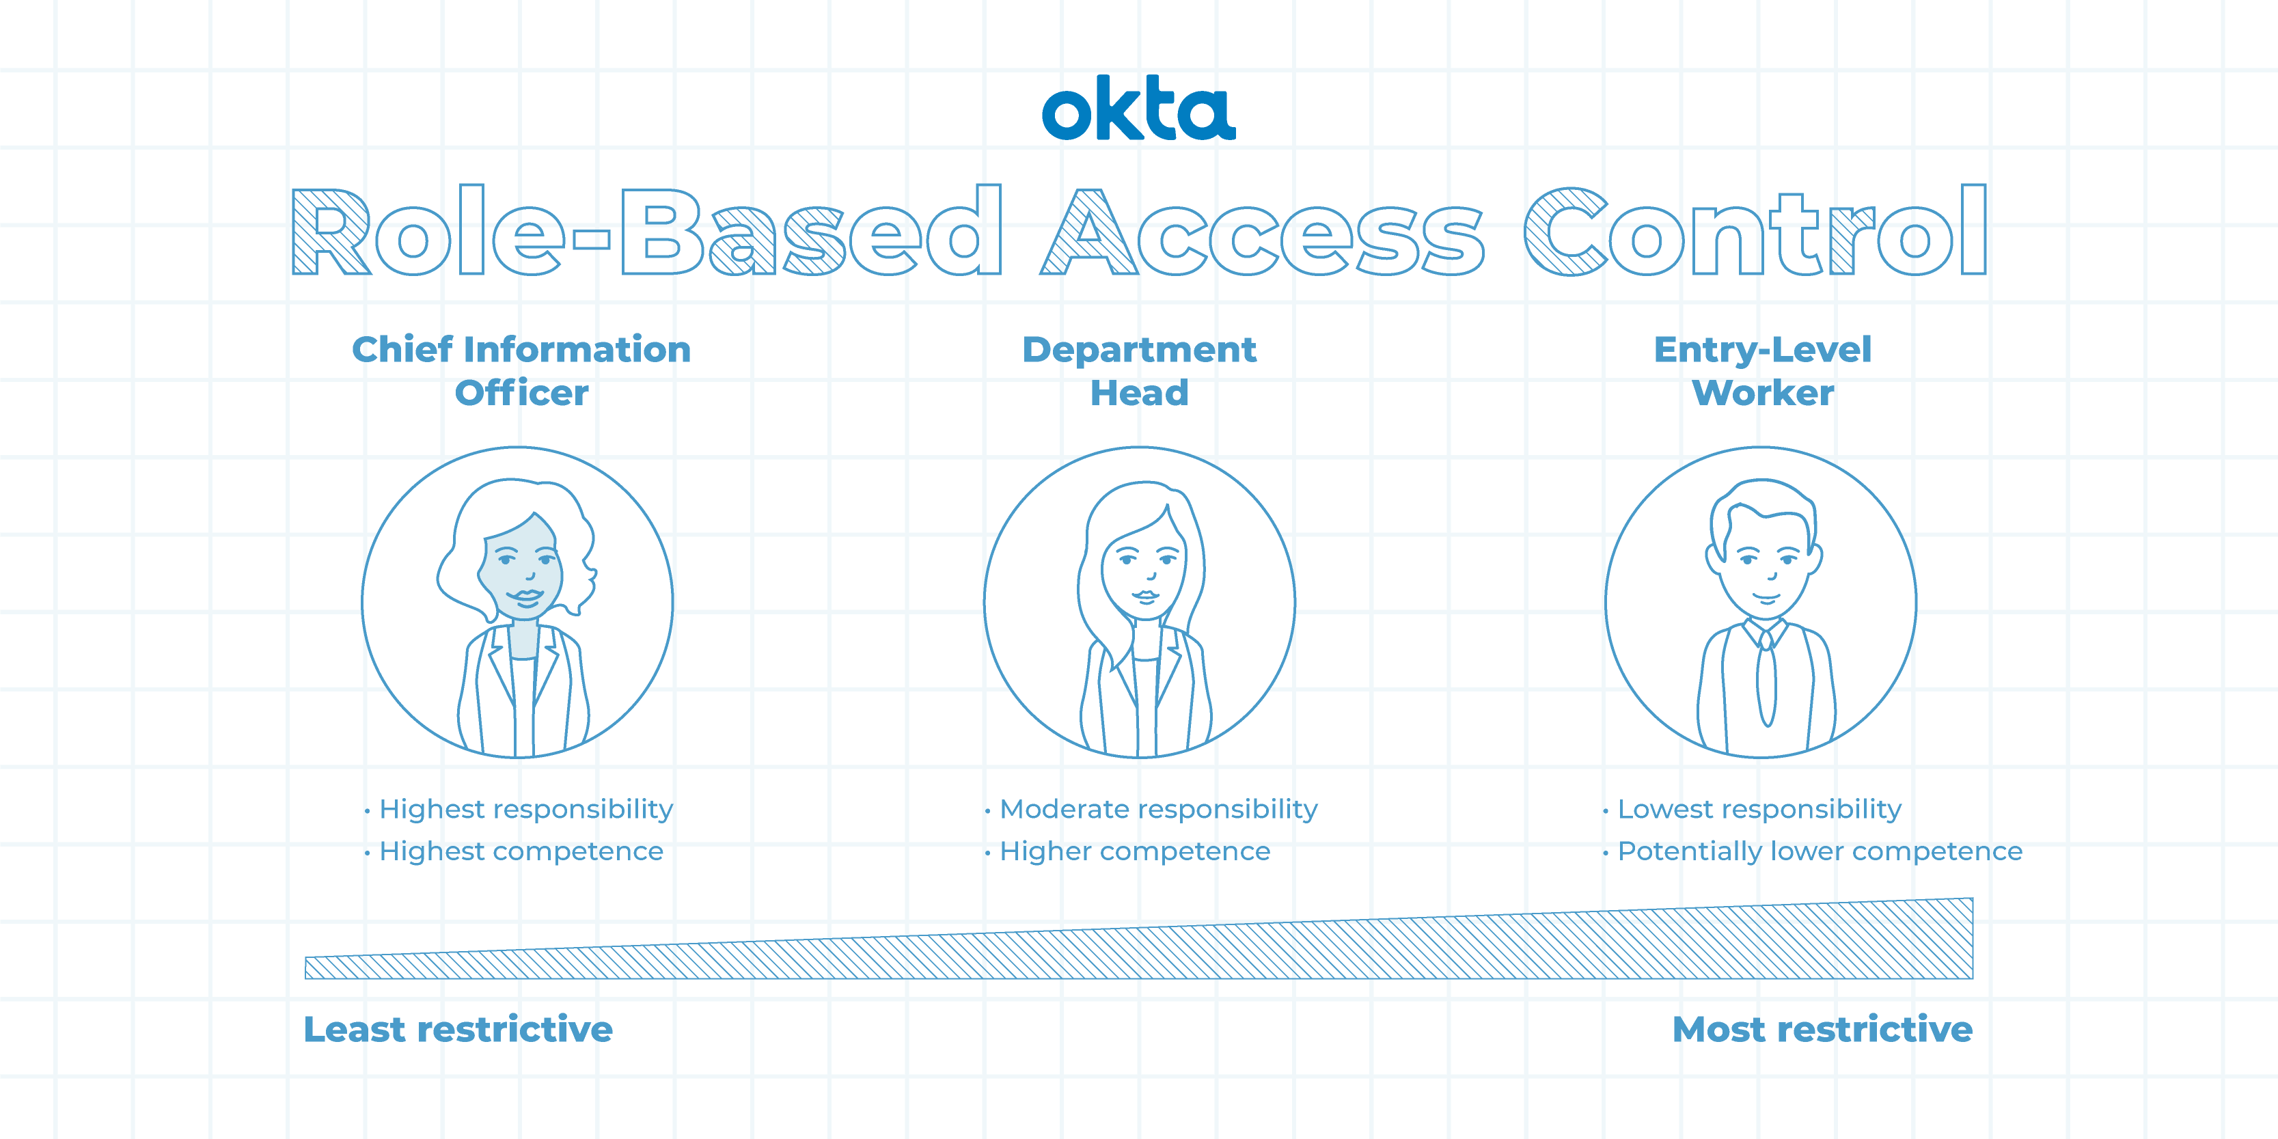
Access Control Methods
Role-Based Access Control (RBAC)

Slide 27
Access Control Methods
Attribute-Based Access Control (ABAC)
Mechanism: ABAC grants access based on the attributes of the user, the resource being accessed, and the context of the request. Attributes can include user characteristics (e.g., department, location, seniority), resource properties (e.g., sensitivity level, data classification), and environmental factors (e.g., time of day, location of access).
Pros: Highly flexible and adaptable to complex access control scenarios. Allows for fine-grained access control based on specific conditions. Supports dynamic access decisions based on real-time context.
Cons: Can be complex to implement and manage. Requires careful definition of attributes and policies. May introduce performance overhead due to the dynamic evaluation of access requests.

Slide 28
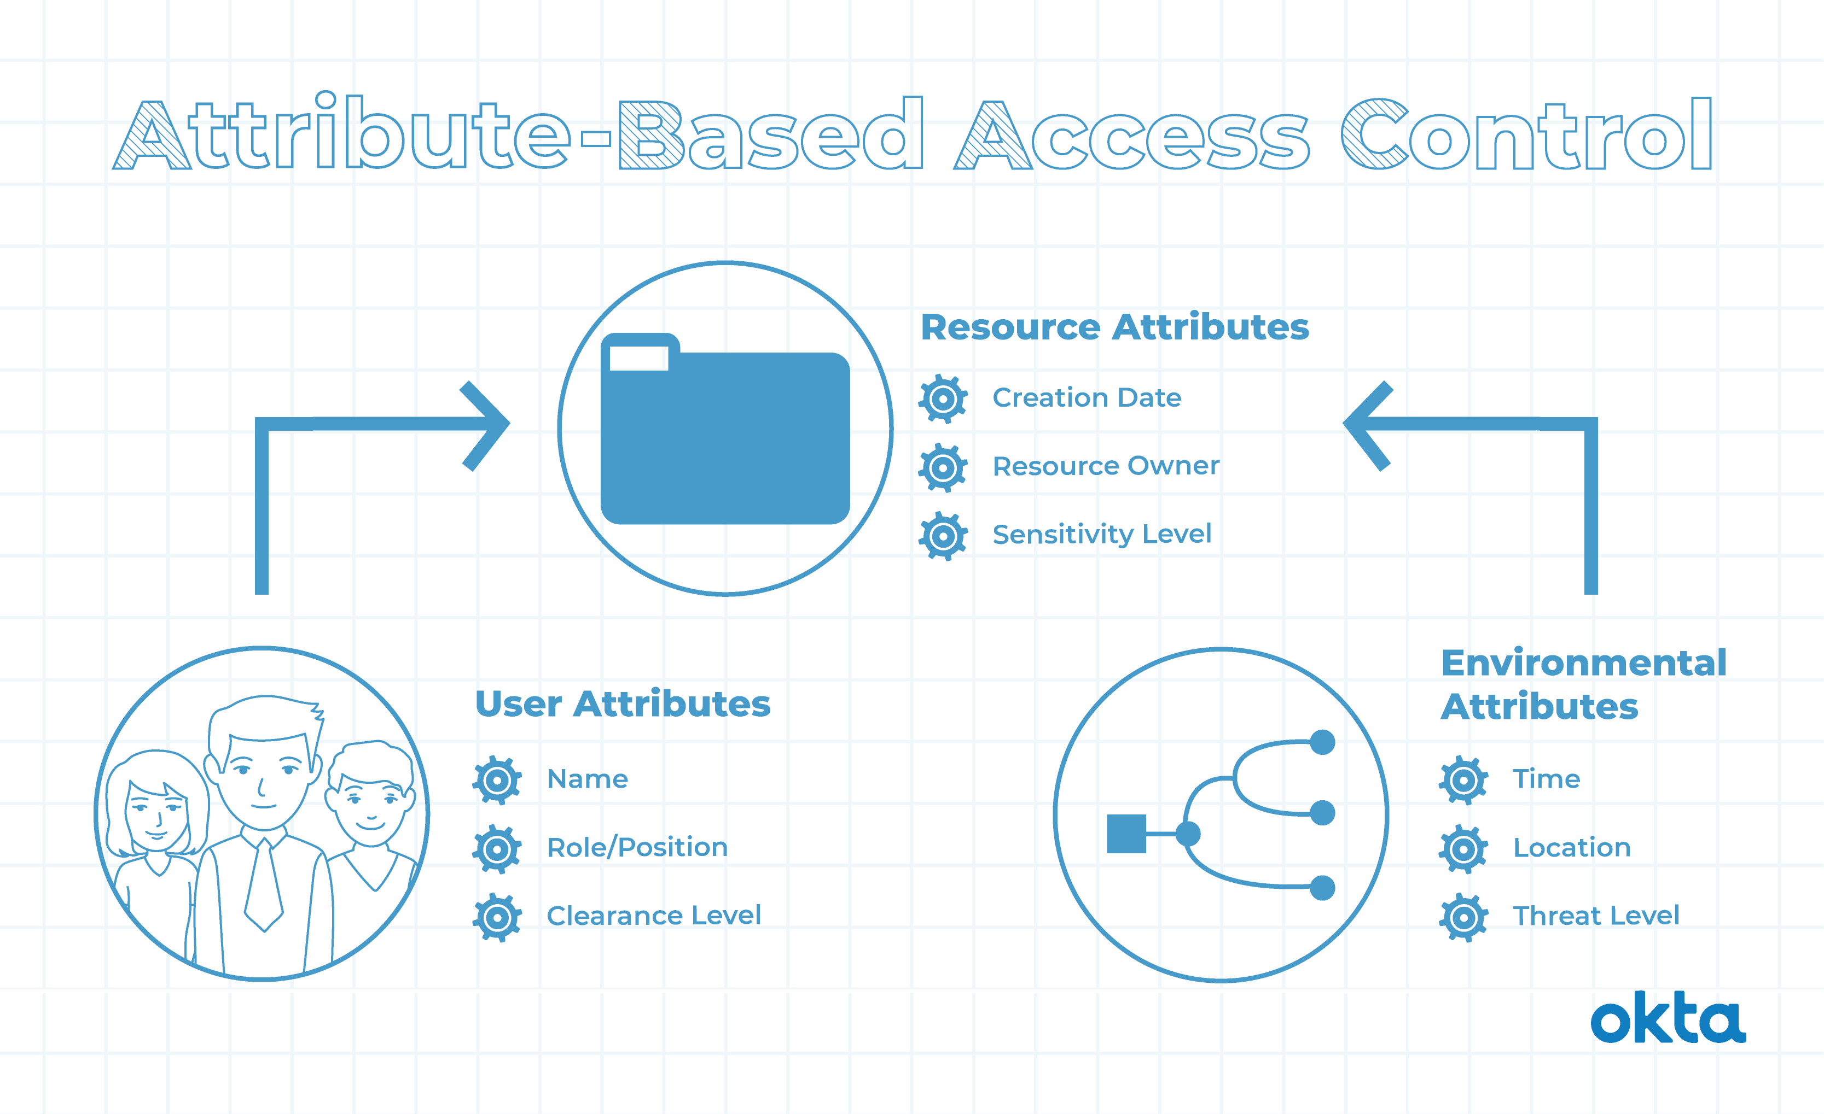
Access Control Methods
Attribute-Based Access Control (ABAC)

Slide 29
Access Control Methods
Discretionary Access Control (DAC)
Mechanism: DAC places the decision-making authority in the hands of the owner of a resource. The owner has the discretion to decide who can access the resource and what actions they can perform.
Pros: Simple and intuitive, as it mirrors how access is often managed in the physical world. Provides flexibility for owners to control access to their resources.
Cons: Can lead to inconsistent access control across an organization. Difficult to audit and manage, as access decisions are decentralized. Prone to errors and security risks if owners are not careful in granting access.

Slide 30
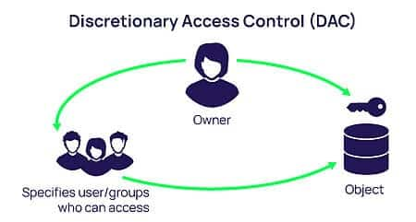
Access Control Methods
Discretionary Access Control (DAC)

Slide 31
Access Control Methods
Choosing the Right Access Control Method
The optimal access control method depends on the specific needs and characteristics of the organization and its resources. Many organizations employ a combination of access control models to address different access control scenarios.
RBAC is often used for managing access to applications and systems where access needs are relatively stable and predictable.
ABAC is suitable for environments with dynamic access requirements or where fine-grained access control is necessary.
DAC may be appropriate for situations where resource owners need full control over access to their resources.

